Slide 1
Lecture 13
Surface Reactions

Slide 2
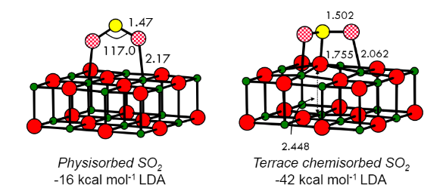
Surface Adsorption
Physisorption
Chemisorption
Exothermic
Often challenging to model due to many possible configurations (Local minima problem).
Conventionally define: E_{ads} = E_{surf+ads} - E_{surf} - E_{ads}

Slide 3
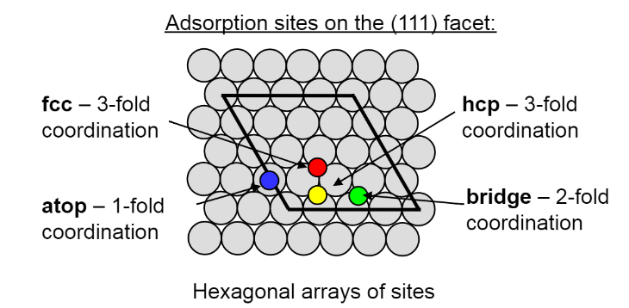
Surface Adsorption
Adsorption analysis tools:
Energy differences
Site-Projected Density of states
Charge density difference
Adsorbate vibrational spectra
Adsorption properties vary across active sites

Slide 4
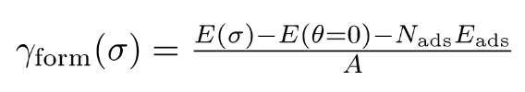
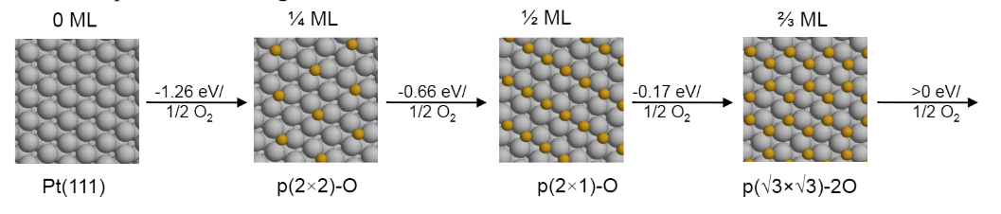
Coverage-Dependent Adsorption
Adsorbate-adsorbate attractions/repulsions can affect surface reactivity by changing the following:
Adsorption energy
Saturation coverage
Reaction barriers

Slide 5
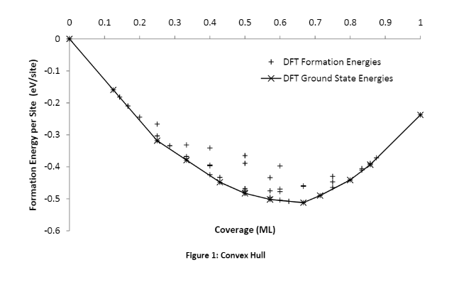
Coverage Dependent Adsorption

Slide 6
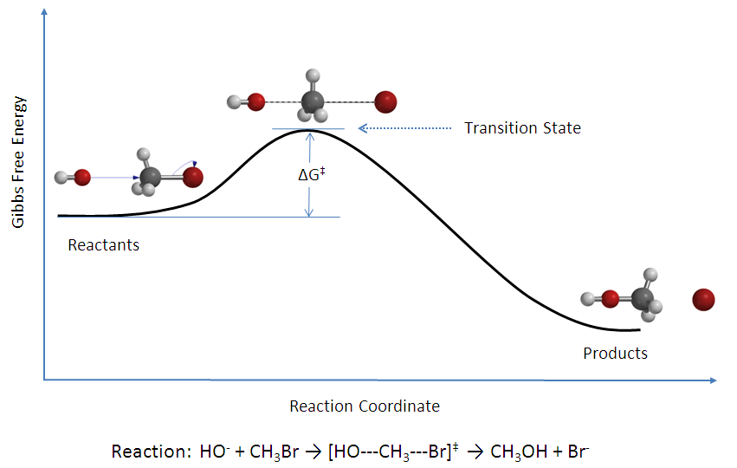
Reaction Barriers Control Rate
Surface reactions proceed through adsorption and diffusion.
For a given step, we have to know or guess the TS to build kinetic models.
Difficult to measure because transition states are generally unstable and short lived. (Femtosecond scale lifetime)
Computationally, TS = Saddle point along the minimum energy pathway (MEP).

Slide 7
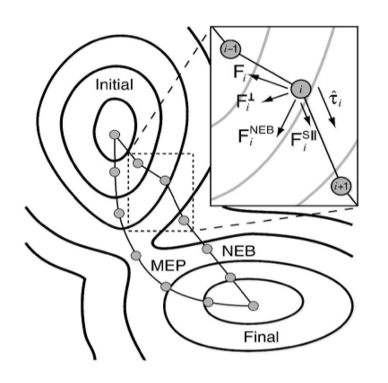
Transition State Calculations
NEB - Nudged Elastic Band treatment: Method for finding a MEP using PES gradients.
Method:
Draw path between PES minima
Discretize path into finite images
Perform an “elastic band” optimization per image.
Perpendicular force optimized. F_{perp} = 0 along the MEP.
Goal is to converge all images to the same pathway.

